Slide 1

MACHINE LEARNING CS5710 CRN-12675

Slide 2
Butterfly Classification Using Machine Techniques
Group Members:
SAI SHIVANI MAMINDLA
KEERTHI POTLAPALLY
DEEKSHITH KORIDE
SIVA SAI KUMAR REDDY ANNEM

Slide 3
Roles & Responsibilities:
Dataset collection: Sai Keerthi Potlapally& Shivani Mamindla
Dataset loading and preprocessing coding: Siva Sai Reddy & Deekshith Koride
Algorithm implementation coding: Sai Keerthi Potlapally, Shivani mamindla, Siva Sai Reddy and Deekshith Koride
Documentation: Sai Keerthi Potlapally and Siva sai ReddyPowerpoint: Shivani Mamindla, Deekshith Koride

Slide 4
Motivation:
Scientists have been working very hard on the global climate change.
In order to help them identify the problems quicker, we wanted to help them in such a way that makes it easier for them to get into the problem solution.
So, after some research we got to know that butterfly species can be used to solve this problem.
So, our motivation is to create a Butterfly classification system with at most accuracy and less time-consuming method.

Slide 5
Objectives:
In this, we are going to classify the butterflies using Logistic Regression, Random Forest Classifiers, Support Vector Machines, K-Nearest Neighbor.
First, we have reshaped the dataset, classified the data of the butterflies using SVM, Random Forest, KNN algorithms for classification.
Then, we compared the predictions of classifications.

Slide 6
Related Work:
Wen et al. incorporated local and global information for insect classification; researchers developed a model that incorporates K nearest neighbor classification (KNNC), regular densities predicated sequential classification model (NDLC), minimal level fewest linear classification algorithm (MLSLC), the nearest mean classifier (NMC), and decision tree (DT). Their experimental results showed an 86.6% classification rate when assessed on images taken during actual field trapping for training.
Faithpraise et al. extracted structural information and used ANN to construct an automatic detection algorithm for copepod species. They assessed an overall accuracy of 93.13 % using seven copepod traits from 240 reference photos. Xie et al. used advanced multiple-task sparse representation and multiple-kernel learning approaches; additional efforts were towards a classification method to categorize butterfly imagery. They applied the conceptual approach to the trial on 24 prevalent farming systems species and contrasted it to some newer approaches

Slide 7
Problem Statement:
Classification of species can be very difficult, since their diversity is not uniformly distributed. Instead, nature is very imbalanced, and some animals are easier to photograph. This is also true within a group of insects, e.g., butterflies. Some butterfly species are more common than others, both in nature and in pictures.
The goal of this research is to create a butterfly classification system with most accuracy and less time-consuming method.

Slide 8
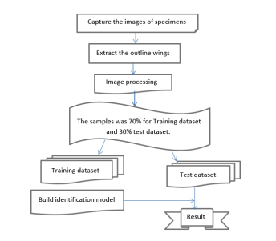
Proposed Solution
A total of 9285 photos have been used which are divided into 75 subdirectories. The top 10 categories have been taken.
We use deep reinforcement learning to present a deep-learning-based technique for fine-grained butterfly classification using specimen photos.
The proposed work classifies butterfly species images into various classes using pre-trained transfer-learning models.

Slide 9
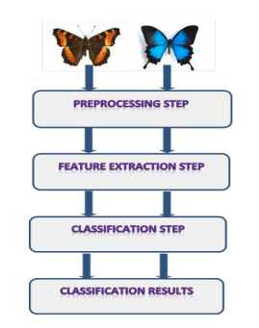
Workflow
As per the Workflow diagram, we first do the preprocessing of the data.
Then, features are extracted form the images of the dataset
Classification of the data is done according to the features extracted.
Then the images of the dataset are classified.

Slide 10

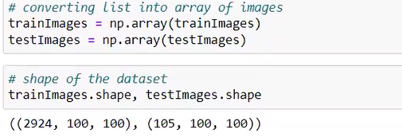
Results:
We have first defined the length of the test and training data
Then, we have converted the data into an array and displayed the shape of the array

Slide 11
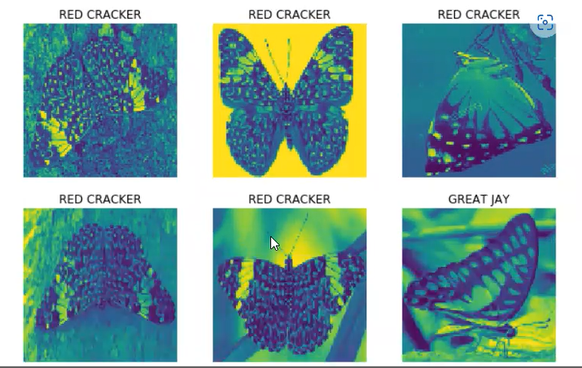
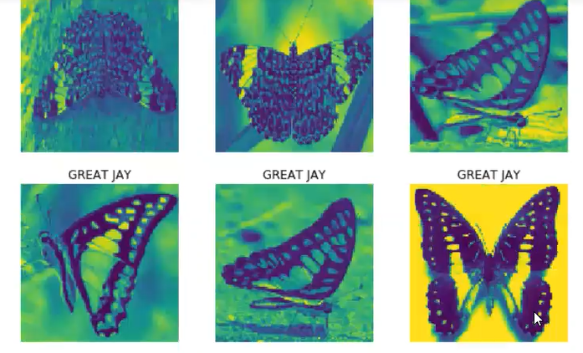
Results:
Displaying the images

Slide 12
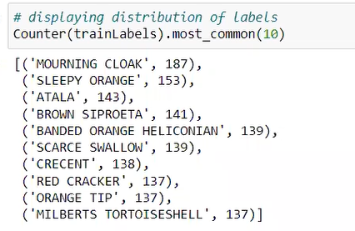
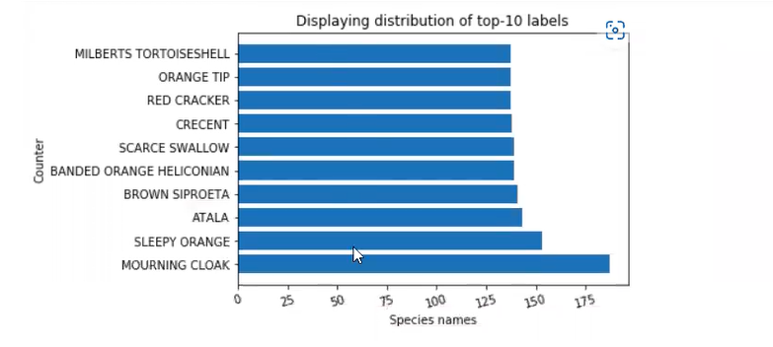
Results:
We have displayed the top 10 categories of the data with the no. of images and also in the graph format.

Slide 13
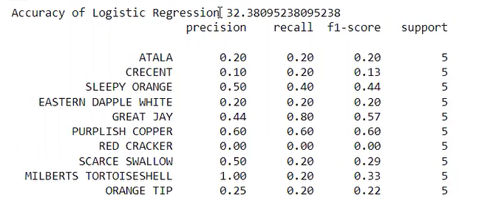
Results:
Now, we have defined all the models, Logistic Regression, Random Forest Classifiers, Support Vector Machines, K-Nearest Neighbor.
Then we have calculated the accuracy of data using all the models:
Logistic Regression:

Slide 14
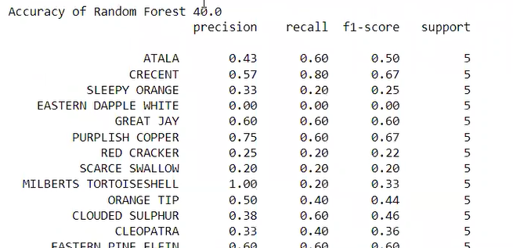
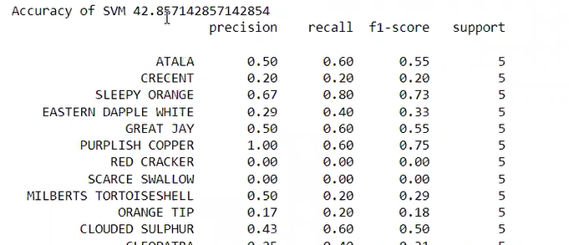
Results:
Random forest:
SVM

Slide 15
References:
Arzar, N.N.K.; Sabri, N.; Johari, N.F.M.; Shari, A.A.; Noordin, M.R.M.; Ibrahim, S. Butterfly species identification using Convolutional Neural Network (CNN). In Proceedings of the 2019 IEEE International Conference on Automatic Control and Intelligent Systems (I2CACIS), Shah Alam, Malaysia, 29 June 2019; IEEE: Piscataway, NJ, USA, 2019; pp. 221–224.
. Li, C.; Zhang, D.; Du, S.; Zhu, Z.; Jia, S.; Qu, Y. A butterfly detection algorithm based on transfer learning and deformable convolution deep learning. Acta Autom. Sin. 2019, 45, 1772–178
Wang, W.; Zhang, J.; Wang, F. Attention bilinear pooling for fine-grained classification. Symmetry 2019, 11, 1033.
Andrian, R.; Maharani, D.; Muhammad, M.A.; Junaidi, A. Butterfly identification using gray level co-occurrence matrix (glcm) extraction feature and k-nearest neighbor (knn) classification. Regist. J. Ilm. Teknol. Sist. Inf. 2019, 6, 11–21.
Shou, J.; Zhou, Y.; Li, Y. Systematic Butterffly Names of the World; Shaanxi Science and Technology Press: Xi’an, China, 2006
Wang, W.; Zhang, J.; Wang, F. Attention bilinear pooling for fine-grained classification. Symmetry 2019, 11, 1033.
Andrian, R.; Maharani, D.; Muhammad, M.A.; Junaidi, A. Butterfly identification using gray level co-occurrence matrix (glcm) extraction feature and k-nearest neighbor (knn) classification. Regist. J. Ilm. Teknol. Sist. Inf. 2019, 6, 11–21.
Li, F.; Xiong, Y. Automatic identification of butterfly species based on HoMSC and GLCMoIB. Vis. Comput. 2018, 34, 1525–1533

Slide 16
THANK YOU

